Slide 1
Notes:
If you are like many people you may not be sure where to get started learning 'The Cloud' and Microsoft Azure. Unlike On-Prem, there are so many ‘shiny things’ that are constantly changing, it’s really heard to figure out where to start. If that is the case, don’t worry; you are not alone, and you’ve come to the right place. I'm Michael Bender, an Author Evangelist at Pluralsight, and today you'll learn where and how to start (or continue) your Cloud career journey. Everyone will leave with ideas to get learning and propel your career forward in The Cloud.

Slide 2
Propelling your Career with Pluralsight and Microsoft Azure
Michael Bender
Author Evangelist, Pluralsight
@MichaelBender
Notes:
If you are like many people you may not be sure where to get started learning 'The Cloud' and Microsoft Azure. Unlike On-Prem, there are so many ‘shiny things’ that are constantly changing, it’s really heard to figure out where to start. If that is the case, don’t worry; you are not alone, and you’ve come to the right place. I'm Michael Bender, an Author Evangelist at Pluralsight, and today you'll learn where and how to start (or continue) your Cloud career journey. Everyone will leave with ideas to get learning and propel your career forward in The Cloud.

Slide 3






Changing Landscape with the Cloud
Notes:
I’m not going to waste any of your time here explaining why you need to learn how to work in the cloud and Microsoft Azure. You’re here because you know that the roles in IT are changing, and you want to change with them.
For years, we saw roles in IT that were silo'd. Maybe you were an exchange admin, managed networking, or developed apps. It was common-place to have that area of focus and go deep in that particular technology. And people were good at that, and successful.
That changes with the cloud. As many of the 'hands-on’ and repetitive tasks are automated, we find that in order to do our job we have to wear many hats, and the area we have to cover has become more broad across the spectrum. This is a challenge for many individuals and organizations
Sure, you might be able to get by just doing Exchange Online only, but chances are the organization that needs Exchange also needs teams, OneDrive, SharePoint, and many other things from the O365 suite of products. And they are going to go to the person that has knowledge across the broader area, even if they are not as deep in a particular area.
Another challenge with the Cloud is the number of areas of focus.
Simply taking a look at all the resources listed in the Azure Portal will make your head spin.
Trans: When I talk with learners, the most common question is “Where do I start?”

Slide 4
Where do I start?
Notes:
My answer is straight-forward.
As you look towards the future and where you want to take your career, you need to widen the lense to see all of the skills you'll need to succeed.

Slide 5




Job Roles in the Cloud
Administrator
Developer
Solutions Architect
Security Engineer
Notes:
That is where the focus on job roles comes in.
Instead of just learning a single technology, a job role is a grouping of complimentary skill sets, that put together, allow you to perform much sought after jobs like Developing apps in Azure, architect solutions for Azure, and administering an Azure environment.
Today, organizations are looking for job roles that span technology stacks. For Instance, many companies looking for an Azure Administrator need someone who understands virtual machines, storage, networking along with platform as a service options like containers, web apps, and maybe software as a service components like Office365. Plus, they probably want some experience with coding like PowerShell, Python, or other languages. Not to mention Security. That is a lot of stuff to cover, but that is the changing world we live in.
For you to be successful in your career, you need to acquire the skills necessary for these sought after roles.
Transition to Demo: A great place to start are certifications for Microsoft Azure.

Slide 6
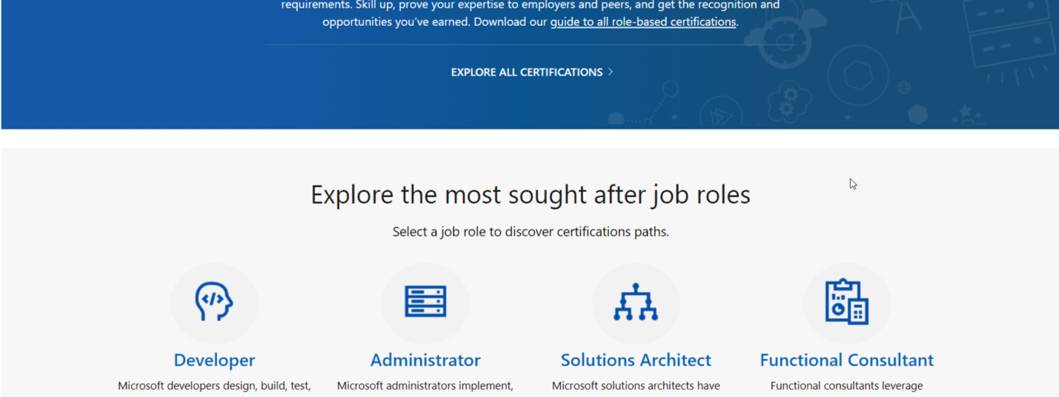
Microsoft Role-Based Certifications
Notes:
Fortunately, you have some help in the Azure world.
With Microsoft's updated certifications, all are role based and designed around in-demand job roles.
Riff on roles, cover top 4
Dive into Administrators
Slide 9 in PDF

Slide 7
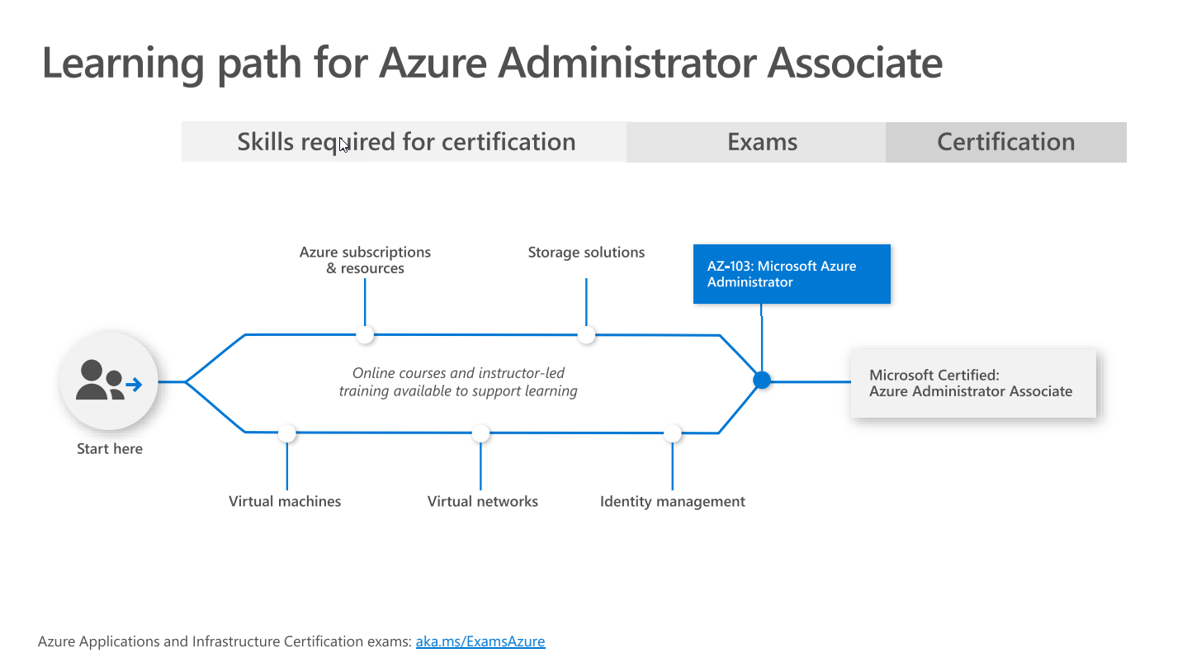
Notes:
Ref: https://query.prod.cms.rt.microsoft.com/cms/api/am/binary/RWtQJJ

Slide 8
Explore Microsoft Role-Based Certs
https://bit.ly/2OTlUpV
Notes:
With Microsoft's updated certifications, many are role based and designed around the in-demand job roles like Developers, Administrators, and Solutions Architect mentioned previously.
With these role-based certs, you focus on the job skills, not the technology skill per se.
Let’s take a look at the Azure Administrator Associate certification.
Starting at Microsoft Landing Page for role-based certifications, you see some of the most sought after job roles.
Let's take a look at all of the certifications.
As you can see there are a lot of certifications. Let's filter this down a bit.
For me, I'm looking for an Administrator job role on azure, and It brings up the Microsoft Certified Azure Administrator Associate.
Exploring the certification, I see
I need to pass AZ-103 for this certification
There Is an optional pre-req exam, Az-900 Azure Fundamentals,
And I need this certifcation If I want to become a certified Azure DevOps Engineer Expert
Under Skills Measured, the skills areas are broken out, very similar to what we saw with RoleIQ. This allows you to target your learning.
So how do you start prepping for to be an Azure Administrator or other Role?

Slide 9
Notes:
Pluralsight is a great place to start.
With over 6700 courses in our catalog, technology professions can find the content they need to skill up and move their career forward.
Our Azure Roles are built around the Role-based certifications in Azure.
Transition: In the case of Microsoft Azure…

Slide 10
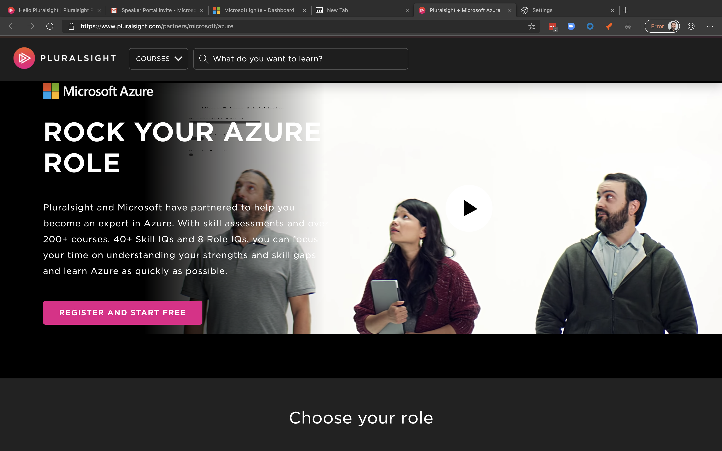
Pluralsight and RoleIQ
Notes:
We've worked directly with Microsoft to co-create content designed to meet the needs of the sought-after job roles in Azure.
There are over 130 courses, with more on the way, and they are available for you to use now for free. All you need to do is complete a quick registration. You don’t have to be a paying pluralsight customer to take advantage of this partnership with Microsoft.
Transition: To assist you with the Azure Roles, let me introduce you to Role IQ

Slide 11



Getting Started with Role IQ
Assess It
Skill Up
Rock Your Role
Notes:
Role IQ quantifies your technical proficiency in a specific role. By measuring your knowledge in relevant skills called Skill IQ, role IQ tells you what level you’re at and shows you what skills you need to work on to build your expertise in a specific job role like Azure Administrator.
To use Role IQ
First, See where you stand by completing skill assessments related to the job role you've chosen.
After completing all the assessments for the job role, you'll receive your Role IQ, which shows what level you are at for the role based on your current technical proficiency.
Now it's time to skill up. Based on your Role IQ score, you receive a curated list of learning opportunities to fill in skills gaps and get to the next level.
And like any learning experience, you need to evaluate to see how you've grown. Through Pluralsight IQ, you have quantifiable data showing what skills have improved and where you can continue to grow and Rock your Role.
Transition: Let's see Role IQ in action for the Azure Administrator job role.

Slide 12
Getting Started with Role IQ and Azure Roles on Pluralsight
http://bit.ly/azure-ps
Notes:
To do that, I'll start at the landing page on pluralsight.com for the free Microsoft Azure Resources. The link, bit.ly/azure-ps, is in the slide deck.
You'll see the eight roles available.
I'll go into the Microsoft Azure Administrator role.
See how the role is broken into categories aligning with this specific job role. Each of these has a Skill IQ assessment available that you'll run through to see where you stand.
To do that, click Check Now, and it will bring up a registration screen.
Registration is quick, and will give you access to all of the free Microsoft Azure content for the role you choose, and the assessments.
Since I already have a pluralsight account, I'll switch over to that account.
Here you see all the roles listed again.
I'll click on Microsoft Azure Administrator, and I can begin the process for Getting my Role IQ by completing the SkillIQ assessments.
Before you start you, you see the assessment topic coverage. You have about 5 minutes to complete approximately 20 questions. I've found this varies by the SkillIQ. Don't worry if you aren't happy with the results the first time as you can do a re-do, and the low score is discarded. And you can always re-test later to see your progress upskilling.
Now let's take a look at a completed RoleIQ for Azure Security Engineer
It looks like I'm level 2, so I have some work to do.
Reviewing each skill area, I can review the personalized content for each.
From here, I'd jump into the content I need to skill up. Upon completing 60% of each section, I can measure my improvement.
And that’s RoleIQ. Isn’t that a great way to measure your skills and beginning ‘leveling up’ your career?
Transition: So maybe you aren’t ready for the full-blown Azure Administrator or Developer job roles just yet. You want to learn the foundational pieces of Azure first.

Slide 13
Getting Started with Microsoft Learn and Docs.com
Notes:
You want to learn the foundational pieces of Azure first.
No Problem!
Notice the first piece of content is a link Azure Fundamentals on Microsoft Learn. Part of docs.Microsoft.com, Microsoft Learn provides a free, online learning platform for technologists everywhere to gain knowledge and hands-on skills with Azure, Microsoft365, and other Microsoft Platforms.
With Azure Fundamentals, you learn key cloud concepts based on azure yet applicable to the broader industry cloud, get an understanding of what services are available in Azure, and learn one of the most important pieces, pricing. Without this solid foundation, it will be difficult to succeed in other job roles.
And notice that this aligns with a Microsoft Certification exam – AZ900 Microsoft Azure Fundamentals
Let’s take a look at how you can get started learning Azure Fundamentals with a free learning platform from Microsoft Learn. <Transition to demo>
Browsing through the learning path, notice it is broken up into Modules. Each module will contain a combination of written documentation, videos, hands-on exercises, and knowledge checks. As you complete modules, you’ll receive experience that is tracked by your Microsoft account.
One of the great features In learn Is a built-In sandbox where you can perform tasks hands-on for free! Yes Free! No azure trial account Is required. You need a Microsoft account.
In the Azure fundamentals learning path, let's check out the Core Cloud Services, Introduction to Azure module.
From the list, notice I have an Exercise - Create a website hosted in Azure. This exercise will walk you through creating a website In Azure using the portal.
First, I'll sign In to activate the sandbox. This process will have a few screens I need to work through to get the permissions needed set up properly.
Once completed, I'll have a sandbox that will allow me to complete this and other exercises. The sandbox has a 4hr time limit, and you can have four sandboxes a day. Important to note: Nothing persists In the sandbox, so when you come back tomorrow, none of your work Is saved, so keep that in mind.
Once complete, I browse down through the exercise directions. I'll open the Azure Portal and see what that gets us. Notice It brings us Into the azure portal using a concierge membership. This Is a policy-limited membership, and you'll be restricted to what you can create with the Resource Group assigned for you.
Sandbox access works with the Azure portal as well as with Azure Cloud Shell. Azure Cloud Shell is a browser-based CLI where you can access your azure subscription using your preferred language, Bash, or PowerShell.
Another option for more self-directed learning is Microsoft Docs, Microsoft's home for documentation. You’ll find all the information you need to begin working with Azure and other Microsoft Services in Docs. And it’s all based out of GitHub and designed to be updated regularly vs. static documentation repositories of the past like Technet. When I worked at Microsoft, I consider this our most important product as it was how our customers learned, and it was community-driven. Many of the docs are updated based on feedback from people in the community.
When I go into Azure, I see several available products.
Let’s look at Azure backup.
Once in Docs, there are many sections to choose from:
Overview is a great place to start to get to an introduction to the products.
Quickstarts are short, 5 minute demos to get you using Azure backup via all the available methods.
Tutorials are longer, scenario based demos.
And Concepts will break down all of the details of Azure Backup for deeper understanding.
I can tell you from my experience building content around Microsoft Azure, Docs.com is the first and sometimes only place I go for getting up to speed with Microsoft products.
The last thing I’ll mention is the feedback. Microsoft believes in treating ‘Documentation as Code,’ thus why it’s in GitHub. As part of that, they want you to help them make better documentation. You can send in feedback, or you can go directly to Github and submit a pull request for updates to docs. I love docs. It’s one of the Microsoft products I use every day besides Windows.
And that’s docs and learn. Two more great tools for learning!

Slide 14




Moving your Career Forward
Choose a
path
Acquire knowledge
Get hands-on experience
Prove your
skills
Notes:
Moving forward, you want to begin by
Exploring the different roles that are available and choose one that matches you. Whether it be one that fits with your current job or a job change, find a role that fits you, and start down the path by getting some knowledge.
Through platforms like Pluralsight, Microsoft Learn, and Microsoft Docs, there are plenty of ways to build your knowledge and skills.
Along the way, make sure you are getting hands-on with Azure so the knowledge sinks in. Remember that Microsoft Docs and Microsoft Learn both provide excellent resources for hands-on learning. And all the courses at Pluralsight are designed for you to follow along within your environment.
And since you’ve put in the work, why not give the certification a shot? In this day and age, certs will make you stand out from the crowd when matched with real-world experience.

Slide 15
Sessions to check out this week
BRK1047 - EXAM PREP: AZ-900 | Microsoft Azure Fundamentals
https://bit.ly/BRK1047
BRK3201 - EXAM PREP: AZ-103 | Microsoft Azure Administrator
https://bit.ly/BRK3201
Learning Paths at Microsoft Ingnite
https://bit.ly/2BQl3hV
Notes:
, I’ve included some sessions you may want to check out this week, either live or recorded for later viewing.
Here are some related to Exam Prep for the AZ-900 and AZ-103 if you want to find out more about those.
Also, check out the learning paths at Microsoft Ignite. In particular, there is an Azure Fundamentals learning path to help you get start on your Azure Journey, along with the 100’s of other sessions on Azure.
Remember, ALL of the breakout and theatre sessions will be available for you to watch should you miss them live.

Slide 16
Resource Slide
Role-based Certifications a Microsoft.com -> https://bit.ly/2OTlUpV
Free Azure Learning Paths at Pluralsight.com -> https://bit.ly/azure-ps
Azure Fundamentals at docs.com/learn -> https://bit.ly/azurefun
Download slides from Tech Community
Notes:
And I have some resources for you to take with you. These are link to all the websites I covered today.
Also, make sure to download the slides and re-view the presentation on Tech Community.
And if you have questions, I’ll be outside the theatre briefly after the talk, and I’ll be in booth #1021 until 6pm tonight, and throughout the week.
O

Slide 17
Thank You!
Questions? Stop by Booth #1021 or @MichaelBender on Twitter
Notes:
And that’s a wrap for propelling your career in Microsoft Azure.
Whether you are starting or already on your journey into Microsoft Azure, you now have the tools you needed to Propel your career to new levels with Pluralsight and Microsoft.
Thanks for coming out today. I’ll be available for questions in a few minutes once I pack up. Also, I’ll be available at the Pluralsight Booth #1021 from 4:30-6 tonight during the conference Happy Hour, and throughout the week. Or hit me up on Twitter. I’m @MichaelBender.
Please make sure to complete your evaluations, and Enjoy the rest of the conference!

